Slide 1
Rapid Deployment of Visualizations
Jason Sippie

Slide 2
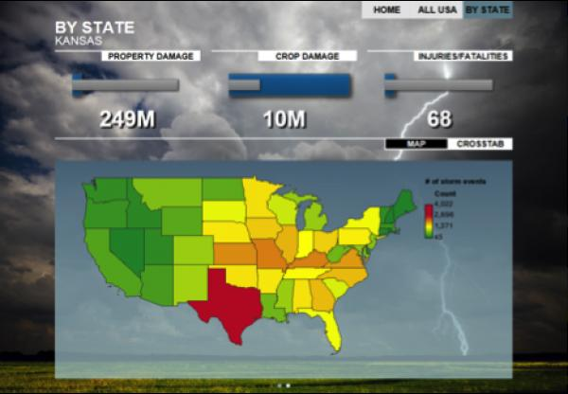
Enterprise Business Intelligence software
Enterprise BI software drawbacks:
Cost
Timeliness
Flexibility
IBM Cognos BI

Slide 3
Shiny to the Rescue
Project:
Deploy a web-enabled visualization prototype with Master/Detail functionality
No more than 20 hours of labor
Zero software cost

Slide 4

2014 and Beyond
Oil Price Trend
WTI down > 50% in 2014

